Slide 1
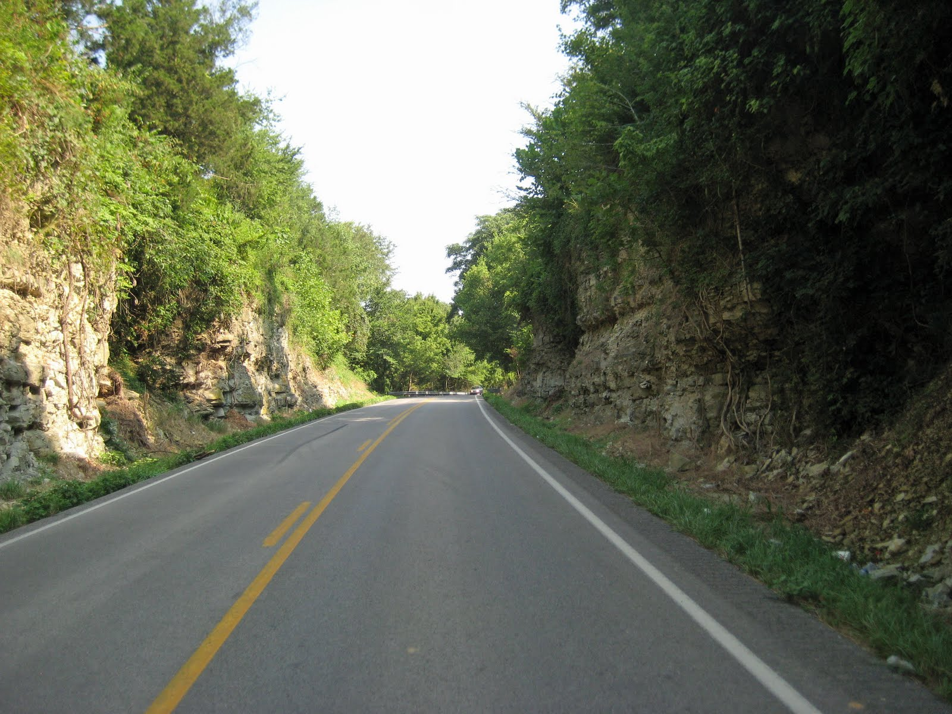
E-invoicing for utilities and rails
_{September 7, 2016}

Slide 2
RECOGNIZING NEEDS
reimbursing should be trackable, accessible and efficient
Drafting
Receiving
Approving
Emars processing
Tracking and Reporting

Slide 3
example:
GENERATING INVOICES
CONSIDERATIONS:
System is built for Utility Companies to generate invoices
Template fills out the document to minimize errors
KYTC users can generate for the Utility Companies
Notes:
In this example, a project is looking at adding lanes to a corridor, and the question is whether to widen the corridor on both sides (potentially affecting everyone) or only on one side. Widening on one side can reduce utility impacts. However, the decision should be taken after taking into consideration factors such as what kind of utilities would be affected and the total estimated cost.

Slide 4
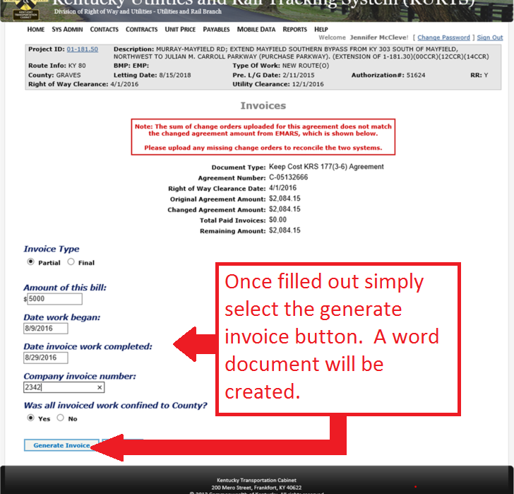
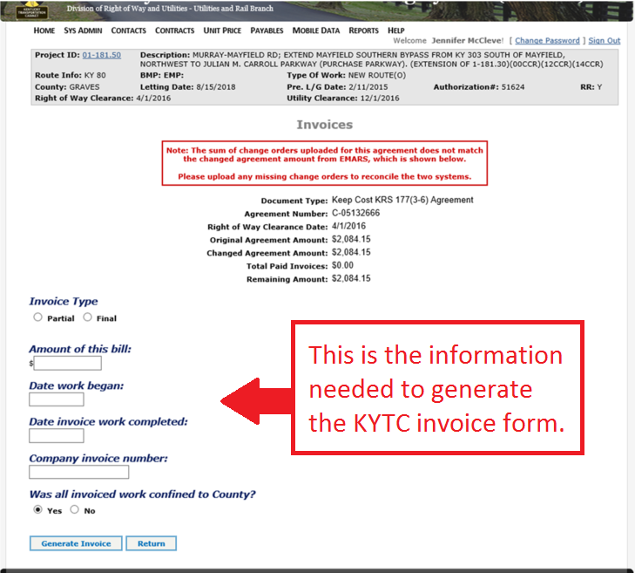
Notes:
Examples of situations where a utility facility is in conflict with a transportation facility.
The property owner arrived home and saw a newly installed pole, which obviously was blocking the driveway. The pole should have been built about 20 feet to the right to coincide roughly with the property line. The situation was corrected soon afterwards.
…
Potential conflict of utility facility with a construction phase.
Picture on the right (courtesy of Ray Sterling): Street in Shanghai. Road construction in preparation for the Shanghai Expo. The sign on the pole warns about construction (and congestion) ahead and directs drivers to take a detour to the right (not clear what drivers; presumably those who may be driving on the same lane as where the pole is located). Both poles and attached utility lines appear to be old and waiting to be relocated.

Slide 5
1 generate invoices\GeneratedInvoice.docx

Slide 6
example:
LOADING INVOICES
CONSIDERATIONS:
System is built for Utility Companies to load electronic invoices
KYTC users can load for the Utility Companies with UC Signature
Invoice must be PDF file types
Invoice submission requires backup documentation.
Notes:
In this example, a project is looking at adding lanes to a corridor, and the question is whether to widen the corridor on both sides (potentially affecting everyone) or only on one side. Widening on one side can reduce utility impacts. However, the decision should be taken after taking into consideration factors such as what kind of utilities would be affected and the total estimated cost.

Slide 7
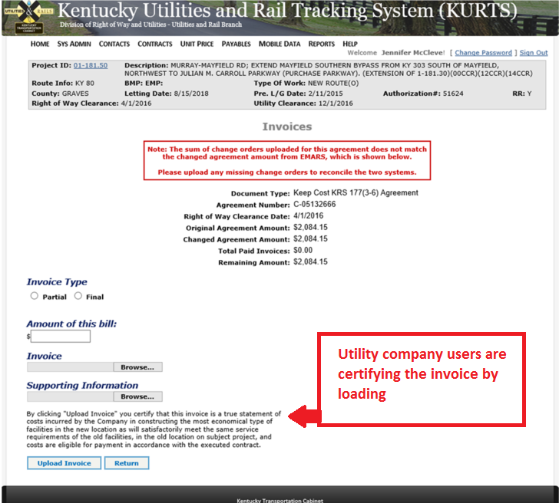
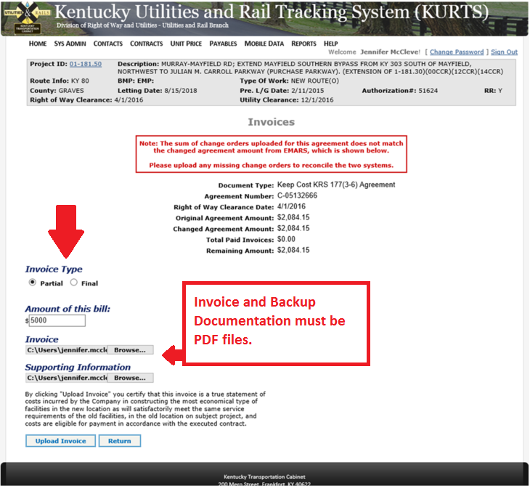
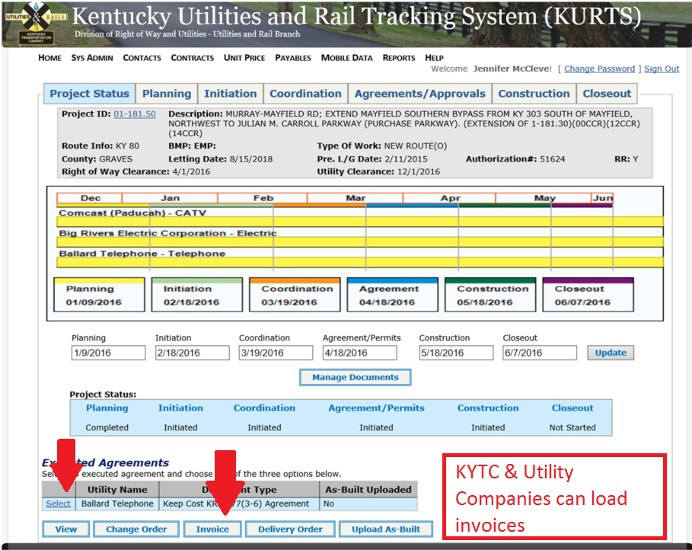
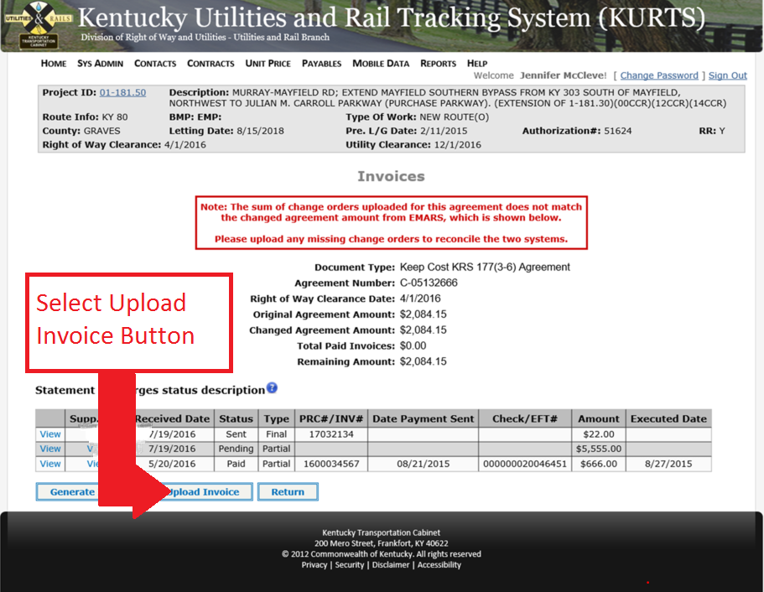
Notes:
Examples of situations where a utility facility is in conflict with a transportation facility.
The property owner arrived home and saw a newly installed pole, which obviously was blocking the driveway. The pole should have been built about 20 feet to the right to coincide roughly with the property line. The situation was corrected soon afterwards.
…
Potential conflict of utility facility with a construction phase.
Picture on the right (courtesy of Ray Sterling): Street in Shanghai. Road construction in preparation for the Shanghai Expo. The sign on the pole warns about construction (and congestion) ahead and directs drivers to take a detour to the right (not clear what drivers; presumably those who may be driving on the same lane as where the pole is located). Both poles and attached utility lines appear to be old and waiting to be relocated.

Slide 8
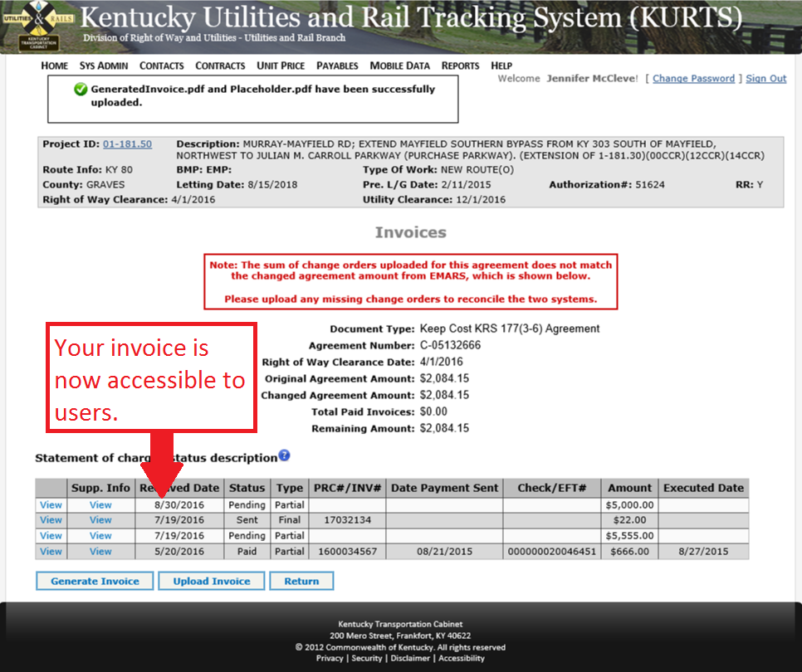
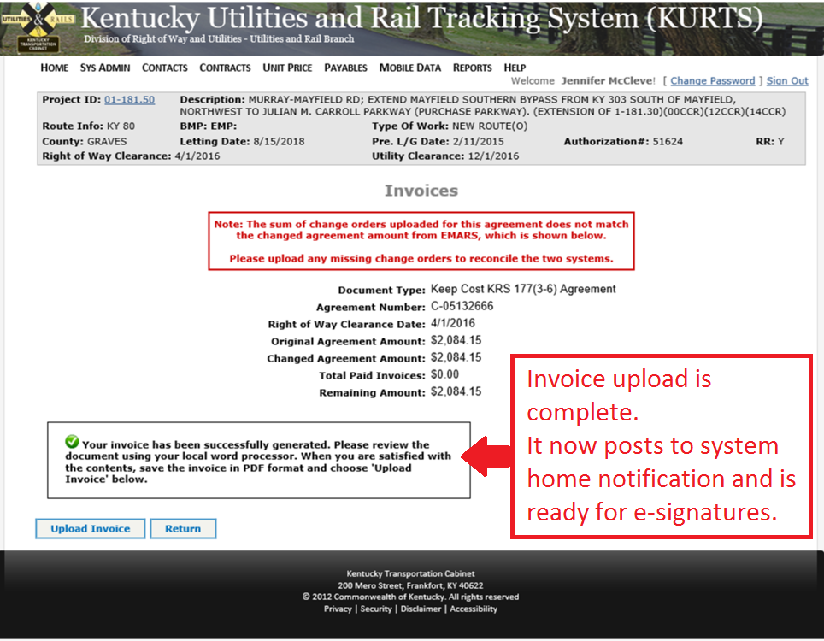
Notes:
Examples of situations where a utility facility is in conflict with a transportation facility.
The property owner arrived home and saw a newly installed pole, which obviously was blocking the driveway. The pole should have been built about 20 feet to the right to coincide roughly with the property line. The situation was corrected soon afterwards.
…
Potential conflict of utility facility with a construction phase.
Picture on the right (courtesy of Ray Sterling): Street in Shanghai. Road construction in preparation for the Shanghai Expo. The sign on the pole warns about construction (and congestion) ahead and directs drivers to take a detour to the right (not clear what drivers; presumably those who may be driving on the same lane as where the pole is located). Both poles and attached utility lines appear to be old and waiting to be relocated.

Slide 9
example:
E-SIGNING INVOICES
CONSIDERATIONS:
Unsigned invoices have a status of ‘Pending’
E-signed invoices have a status of ‘Processed’
E-signatures for KEEP COST FINAL BILLS include CO
Notes:
In this example, a project is looking at adding lanes to a corridor, and the question is whether to widen the corridor on both sides (potentially affecting everyone) or only on one side. Widening on one side can reduce utility impacts. However, the decision should be taken after taking into consideration factors such as what kind of utilities would be affected and the total estimated cost.

Slide 10
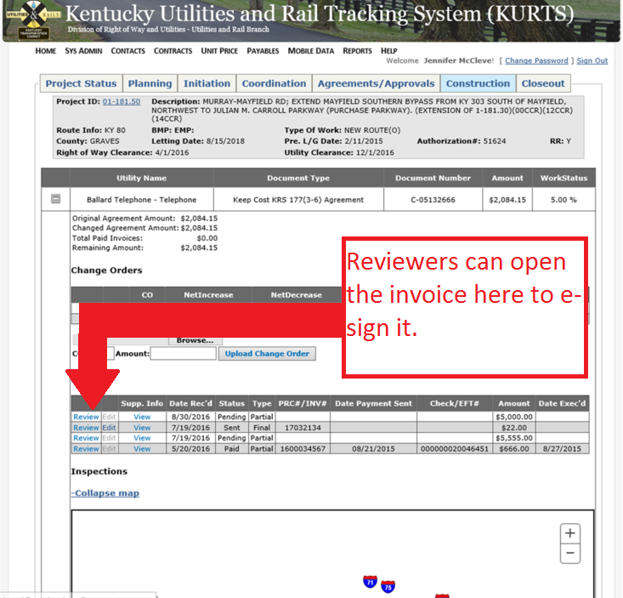
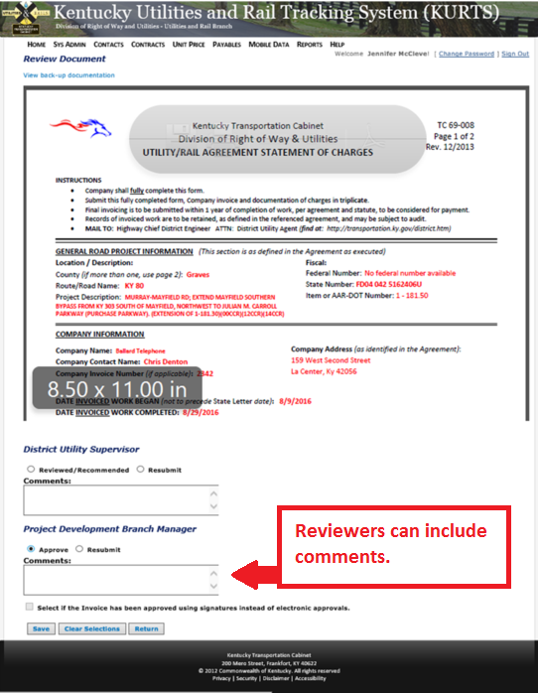
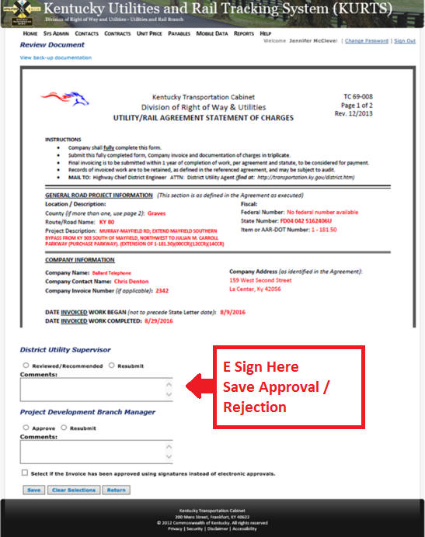
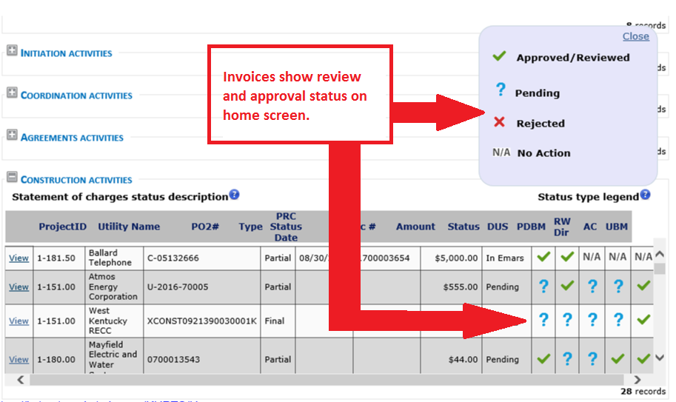
Notes:
Examples of situations where a utility facility is in conflict with a transportation facility.
The property owner arrived home and saw a newly installed pole, which obviously was blocking the driveway. The pole should have been built about 20 feet to the right to coincide roughly with the property line. The situation was corrected soon afterwards.
…
Potential conflict of utility facility with a construction phase.
Picture on the right (courtesy of Ray Sterling): Street in Shanghai. Road construction in preparation for the Shanghai Expo. The sign on the pole warns about construction (and congestion) ahead and directs drivers to take a detour to the right (not clear what drivers; presumably those who may be driving on the same lane as where the pole is located). Both poles and attached utility lines appear to be old and waiting to be relocated.

Slide 11
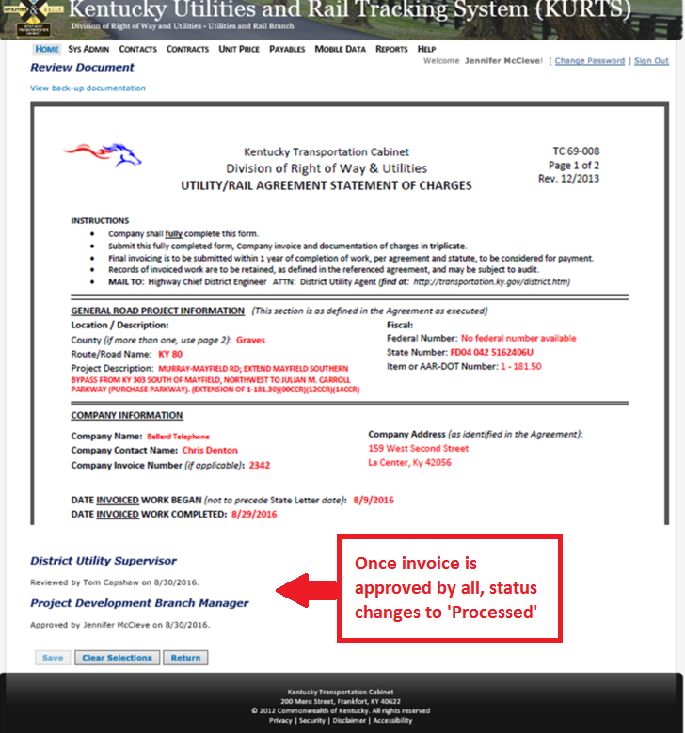
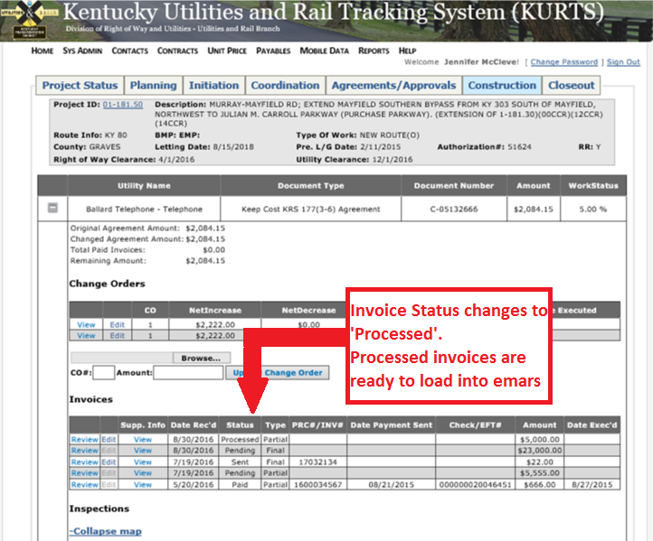
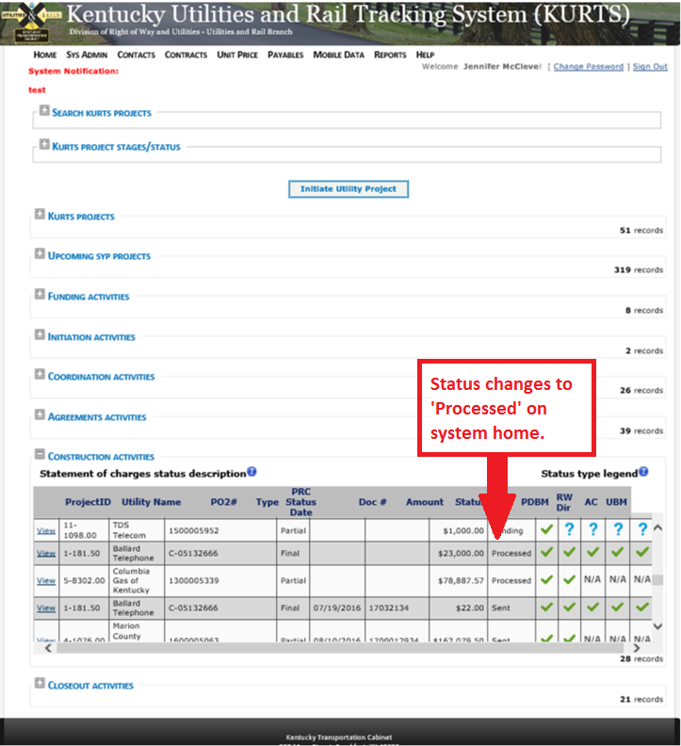
Notes:
Examples of situations where a utility facility is in conflict with a transportation facility.
The property owner arrived home and saw a newly installed pole, which obviously was blocking the driveway. The pole should have been built about 20 feet to the right to coincide roughly with the property line. The situation was corrected soon afterwards.
…
Potential conflict of utility facility with a construction phase.
Picture on the right (courtesy of Ray Sterling): Street in Shanghai. Road construction in preparation for the Shanghai Expo. The sign on the pole warns about construction (and congestion) ahead and directs drivers to take a detour to the right (not clear what drivers; presumably those who may be driving on the same lane as where the pole is located). Both poles and attached utility lines appear to be old and waiting to be relocated.

Slide 12
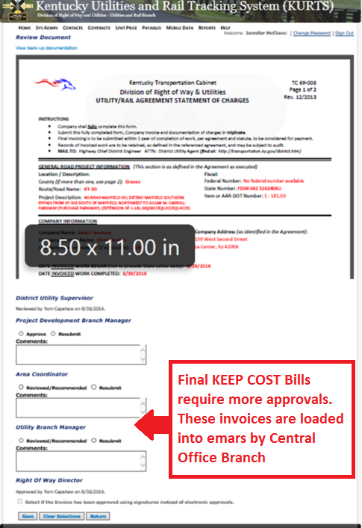
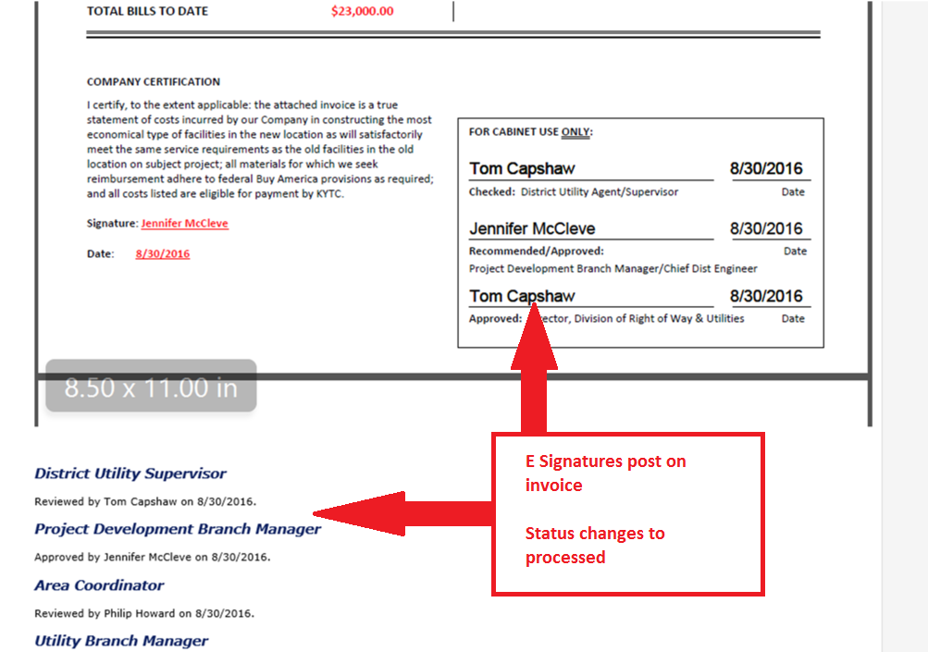
Notes:
Examples of situations where a utility facility is in conflict with a transportation facility.
The property owner arrived home and saw a newly installed pole, which obviously was blocking the driveway. The pole should have been built about 20 feet to the right to coincide roughly with the property line. The situation was corrected soon afterwards.
…
Potential conflict of utility facility with a construction phase.
Picture on the right (courtesy of Ray Sterling): Street in Shanghai. Road construction in preparation for the Shanghai Expo. The sign on the pole warns about construction (and congestion) ahead and directs drivers to take a detour to the right (not clear what drivers; presumably those who may be driving on the same lane as where the pole is located). Both poles and attached utility lines appear to be old and waiting to be relocated.

Slide 13
example:
APPROVING INVOICES IN EMARS
CONSIDERATIONS:
Emars processors load PRC# in KURTS for ‘Processed’ Invoices
Emars approvers find ‘In Emars’ invoice list in KURTS
Notes:
In this example, a project is looking at adding lanes to a corridor, and the question is whether to widen the corridor on both sides (potentially affecting everyone) or only on one side. Widening on one side can reduce utility impacts. However, the decision should be taken after taking into consideration factors such as what kind of utilities would be affected and the total estimated cost.

Slide 14
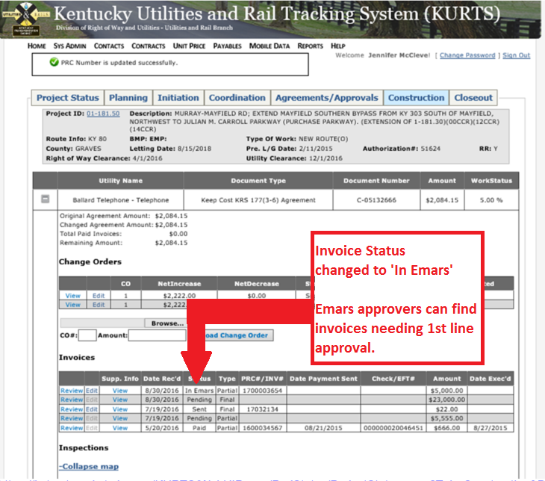
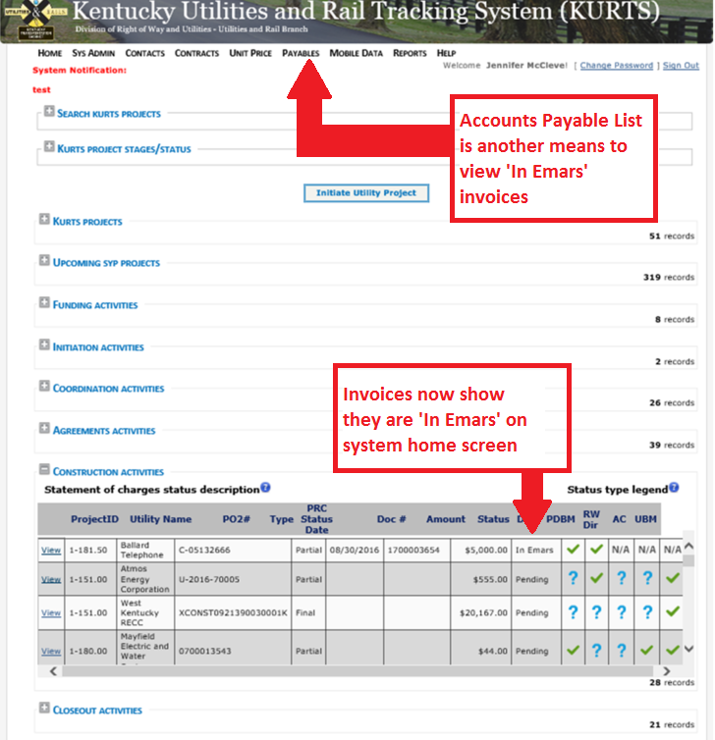
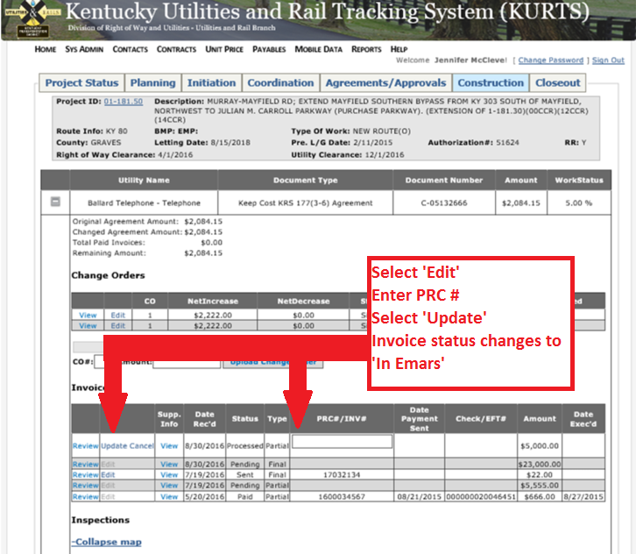
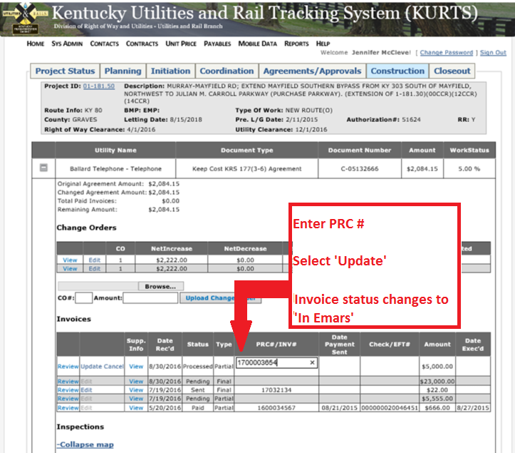
Notes:
Examples of situations where a utility facility is in conflict with a transportation facility.
The property owner arrived home and saw a newly installed pole, which obviously was blocking the driveway. The pole should have been built about 20 feet to the right to coincide roughly with the property line. The situation was corrected soon afterwards.
…
Potential conflict of utility facility with a construction phase.
Picture on the right (courtesy of Ray Sterling): Street in Shanghai. Road construction in preparation for the Shanghai Expo. The sign on the pole warns about construction (and congestion) ahead and directs drivers to take a detour to the right (not clear what drivers; presumably those who may be driving on the same lane as where the pole is located). Both poles and attached utility lines appear to be old and waiting to be relocated.

Slide 15
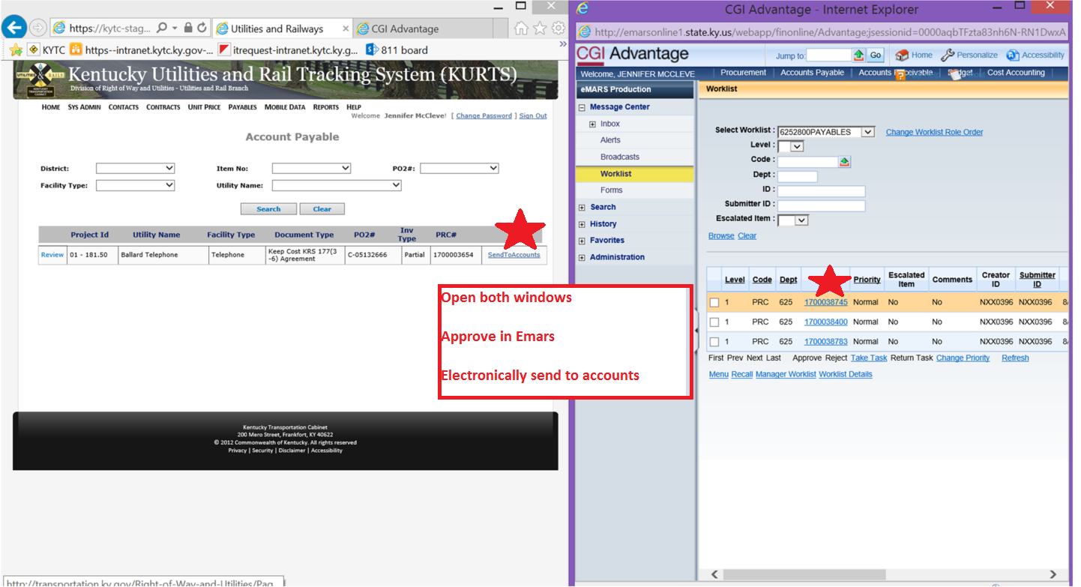
Notes:
Examples of situations where a utility facility is in conflict with a transportation facility.
The property owner arrived home and saw a newly installed pole, which obviously was blocking the driveway. The pole should have been built about 20 feet to the right to coincide roughly with the property line. The situation was corrected soon afterwards.
…
Potential conflict of utility facility with a construction phase.
Picture on the right (courtesy of Ray Sterling): Street in Shanghai. Road construction in preparation for the Shanghai Expo. The sign on the pole warns about construction (and congestion) ahead and directs drivers to take a detour to the right (not clear what drivers; presumably those who may be driving on the same lane as where the pole is located). Both poles and attached utility lines appear to be old and waiting to be relocated.

Slide 16
example:
MONITORING INVOICES
CONSIDERATIONS:
Invoices post to System Home Screen until completed
KURTS gets invoice status from EMARS
Utility Companies can see invoice status
Notes:
In this example, a project is looking at adding lanes to a corridor, and the question is whether to widen the corridor on both sides (potentially affecting everyone) or only on one side. Widening on one side can reduce utility impacts. However, the decision should be taken after taking into consideration factors such as what kind of utilities would be affected and the total estimated cost.

Slide 17
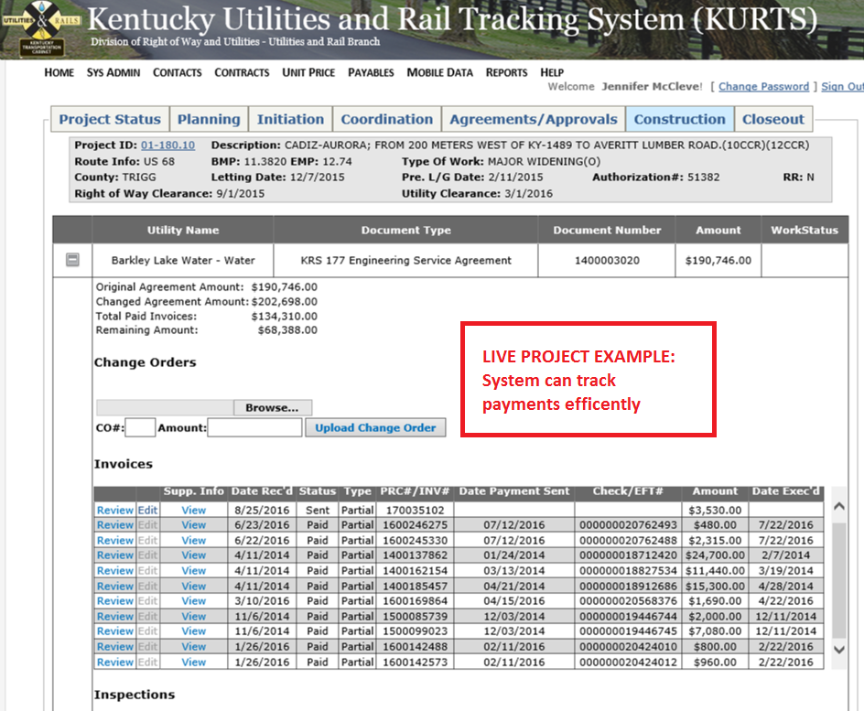
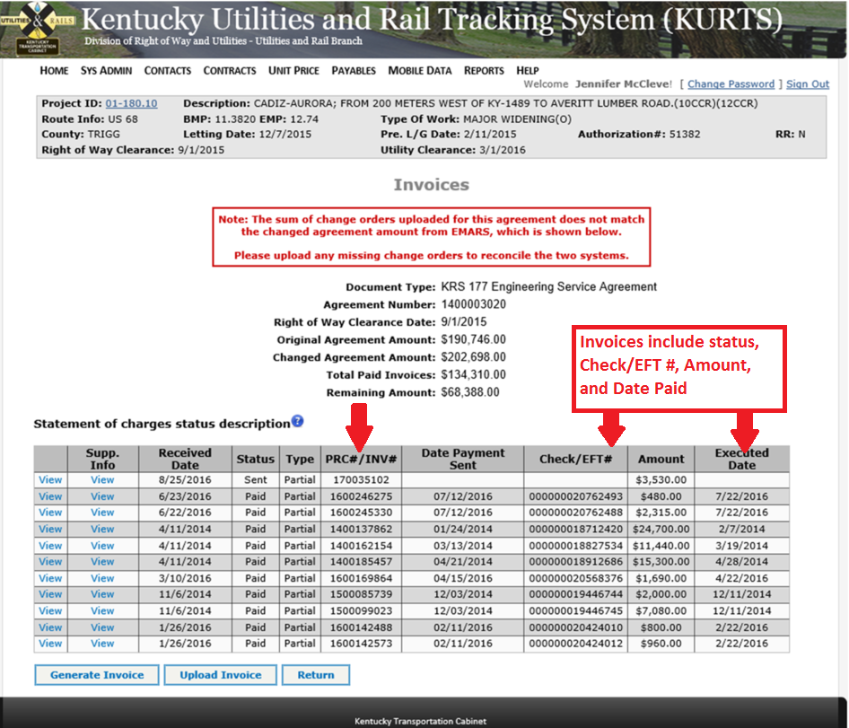
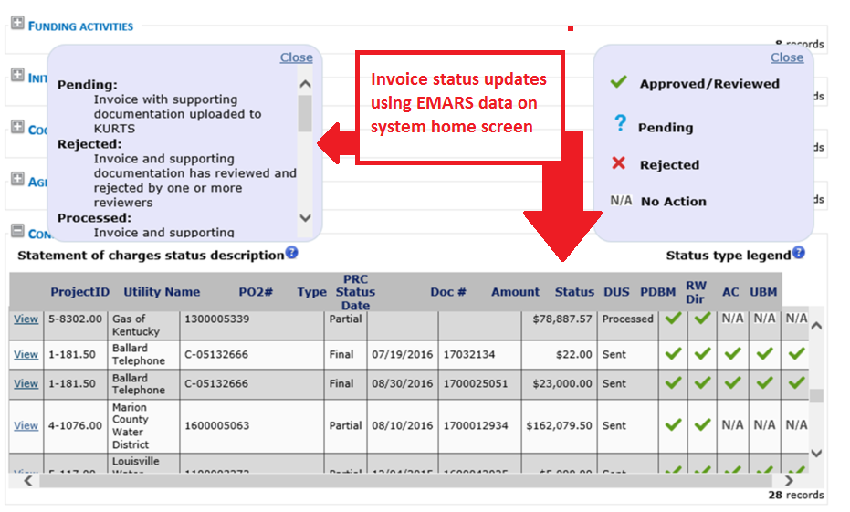
Notes:
Examples of situations where a utility facility is in conflict with a transportation facility.
The property owner arrived home and saw a newly installed pole, which obviously was blocking the driveway. The pole should have been built about 20 feet to the right to coincide roughly with the property line. The situation was corrected soon afterwards.
…
Potential conflict of utility facility with a construction phase.
Picture on the right (courtesy of Ray Sterling): Street in Shanghai. Road construction in preparation for the Shanghai Expo. The sign on the pole warns about construction (and congestion) ahead and directs drivers to take a detour to the right (not clear what drivers; presumably those who may be driving on the same lane as where the pole is located). Both poles and attached utility lines appear to be old and waiting to be relocated.

Slide 18
Pending:
Invoice with supporting documentation uploaded to KURTS
Rejected:
Invoice and backup was rejected by one or more reviewers
Processed:
Invoice and supporting documentation has been reviewed and approved by all reviewers
In EMARS:
Invoice PRC# has been created in EMARS
Sent:
Invoice has had first level approval accomplished in EMARS; Invoice and supporting documentation has been submitted to Division of Accounts
Disbursed:
Payment for invoice has been sent to customer
Paid:
Payment has been cashed with notification back to EMARS

Slide 19
example:
USEFUL REPORTS
Notes:
In this example, a project is looking at adding lanes to a corridor, and the question is whether to widen the corridor on both sides (potentially affecting everyone) or only on one side. Widening on one side can reduce utility impacts. However, the decision should be taken after taking into consideration factors such as what kind of utilities would be affected and the total estimated cost.

Slide 20
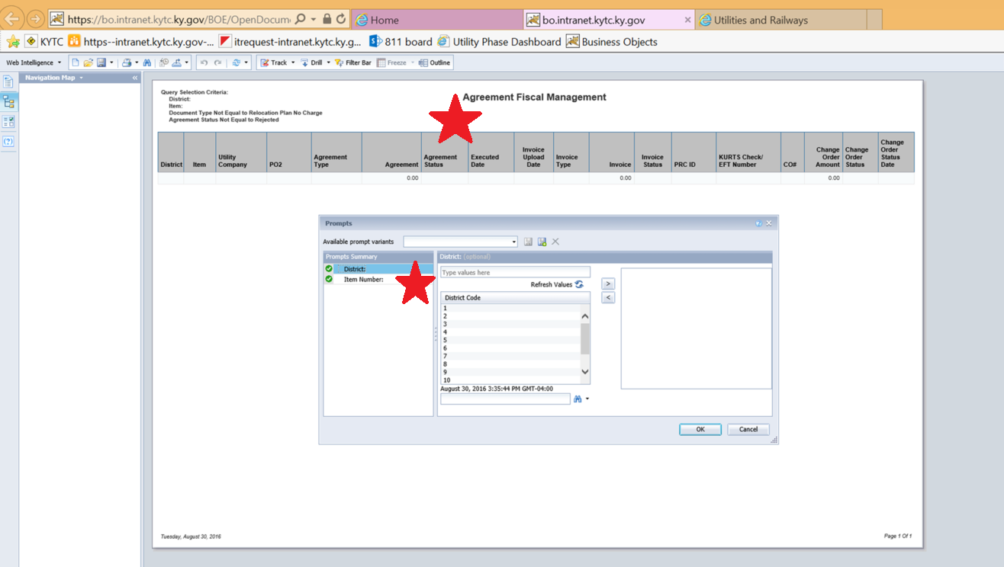
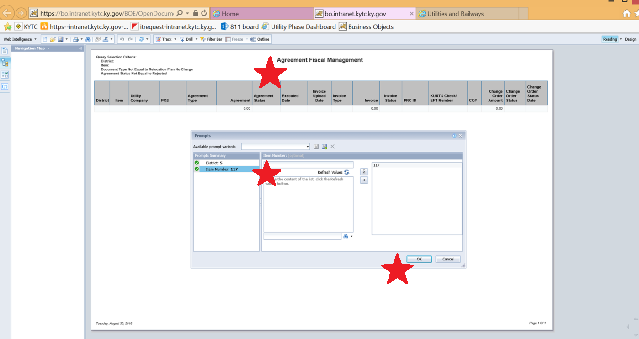
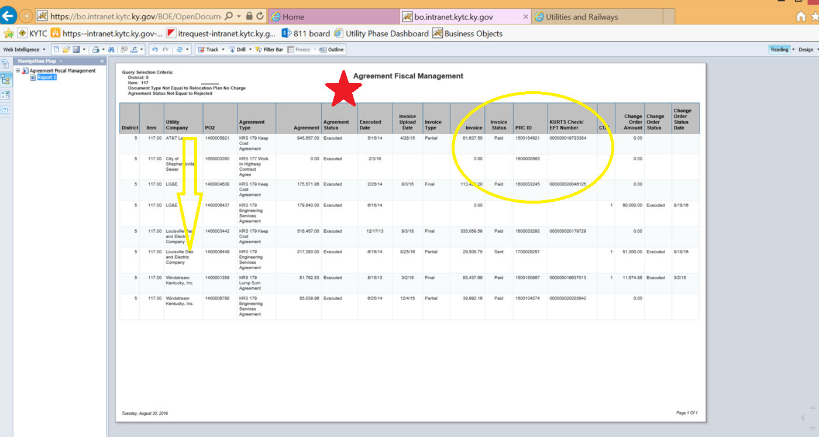
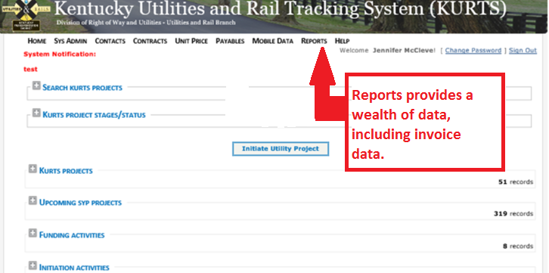
Notes:
Examples of situations where a utility facility is in conflict with a transportation facility.
The property owner arrived home and saw a newly installed pole, which obviously was blocking the driveway. The pole should have been built about 20 feet to the right to coincide roughly with the property line. The situation was corrected soon afterwards.
…
Potential conflict of utility facility with a construction phase.
Picture on the right (courtesy of Ray Sterling): Street in Shanghai. Road construction in preparation for the Shanghai Expo. The sign on the pole warns about construction (and congestion) ahead and directs drivers to take a detour to the right (not clear what drivers; presumably those who may be driving on the same lane as where the pole is located). Both poles and attached utility lines appear to be old and waiting to be relocated.

Slide 21
6 reporting\Agreement_Fiscal_Management.pdf

Slide 22
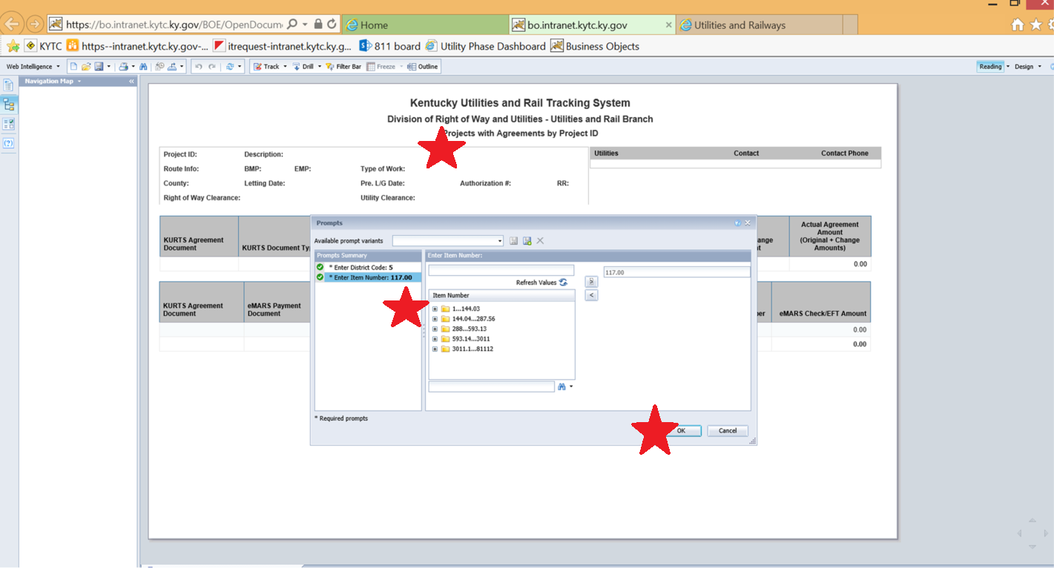
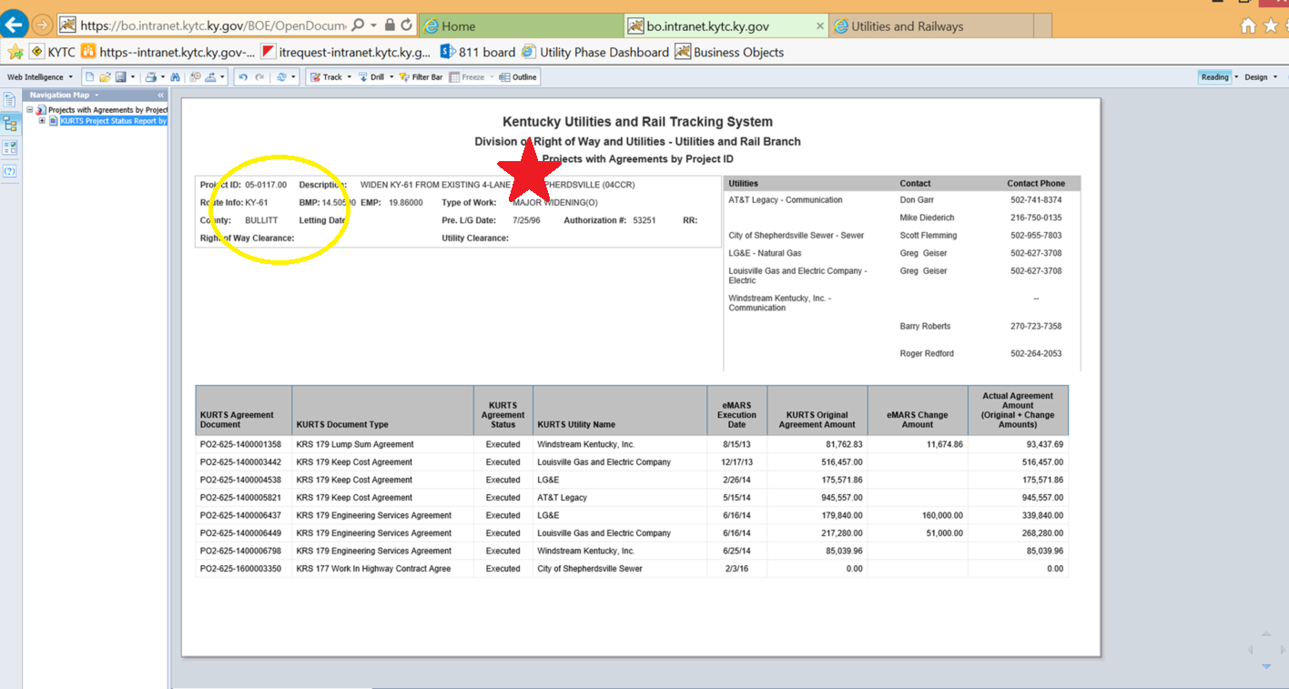
Notes:
Examples of situations where a utility facility is in conflict with a transportation facility.
The property owner arrived home and saw a newly installed pole, which obviously was blocking the driveway. The pole should have been built about 20 feet to the right to coincide roughly with the property line. The situation was corrected soon afterwards.
…
Potential conflict of utility facility with a construction phase.
Picture on the right (courtesy of Ray Sterling): Street in Shanghai. Road construction in preparation for the Shanghai Expo. The sign on the pole warns about construction (and congestion) ahead and directs drivers to take a detour to the right (not clear what drivers; presumably those who may be driving on the same lane as where the pole is located). Both poles and attached utility lines appear to be old and waiting to be relocated.

Slide 23
6 reporting\Projects_with_Agreements_by_Project_ID.pdf

Slide 24
Pending:
Invoice with supporting documentation uploaded to KURTS
Rejected:
Invoice and backup was rejected by one or more reviewers
Processed:
Invoice and supporting documentation has been reviewed and approved by all reviewers
In EMARS:
Invoice PRC# has been created in EMARS
Sent:
Invoice has had first level approval accomplished in EMARS; Invoice and supporting documentation has been submitted to Division of Accounts
Disbursed:
Payment for invoice has been sent to customer
Paid:
Payment has been cashed with notification back to EMARS

Slide 25
Status’ to note:
Pending – Need E-sign
Processed – Need PRC#
In Emars – Need Emars approval

Slide 26
IN SUMMARY …
Electronic Invoicing encompasses all tasks
E-invoicing needs Utility Company use
Included in E-Invoicing:
Generating / Drafting
Loading / Submitting
E-signing
Send to Accounts
Tracking
Reporting
Notes:
In response to the varying use of UCMs across the country, the research team developed three products:
Product 1 is a compact standalone UCM in Excel format that uses 23 data items and can be immediately used.
Product 2 is an flexible, scalable data model and database that can accommodate a large number of UCMs. Depending on the level of implementation, involvement by IT personnel at the DOT may be necessary.
Product 3 is the one-day UCM training course.

